Slide 1



Quality Standard
Q&A

Slide 2


Introduction
IRB is one of the leading marketing data and analytics companies in the
world. We specialize in data collection (quant & qual), survey design, and
sampling methodologies. Our unrivalled panel network of 2.4M+ panel members span 28 countries and includes B2B audiences and consumers across all industry verticals. With 13+ years in the industry, we thrive on quality by delivering the most meaningful data with accuracy - all at a quick speed backed by industry validated technology.

Slide 3


P.E.E.P - Panel Engagement & Elimination Process
Our Methodology
2 core dimensions of our research methodology
K.Y.R - Know Your Respondents Technology

Slide 4

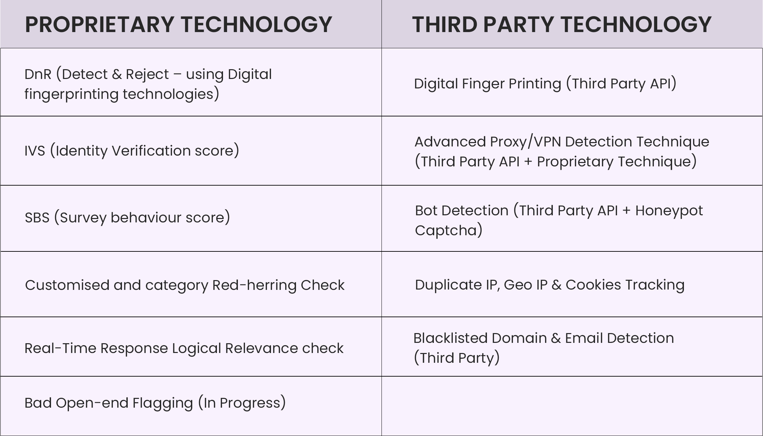
Our Technology

Slide 5

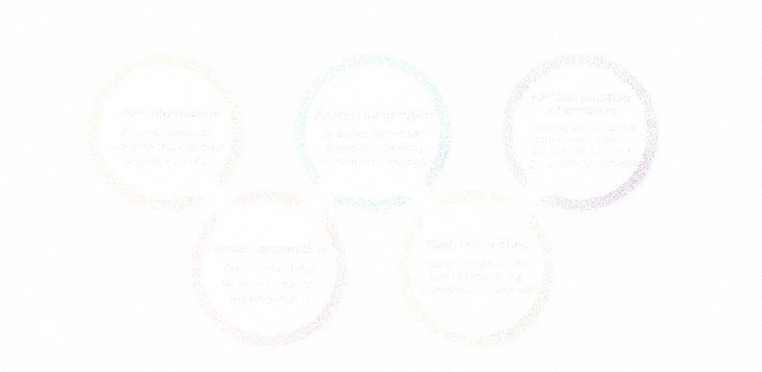
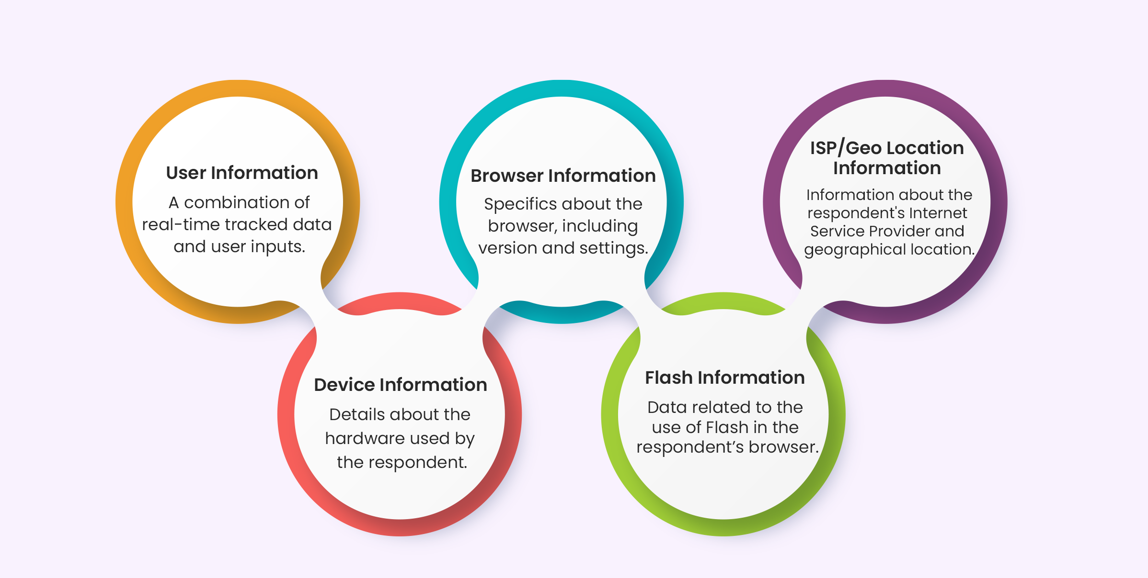
Measure #1 Real-Time Manual Validation

Slide 6
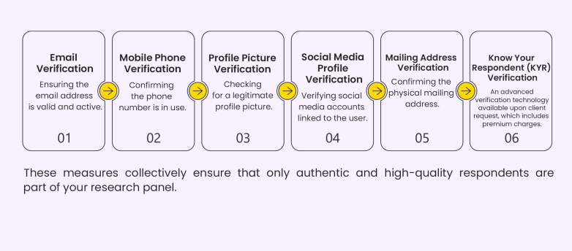
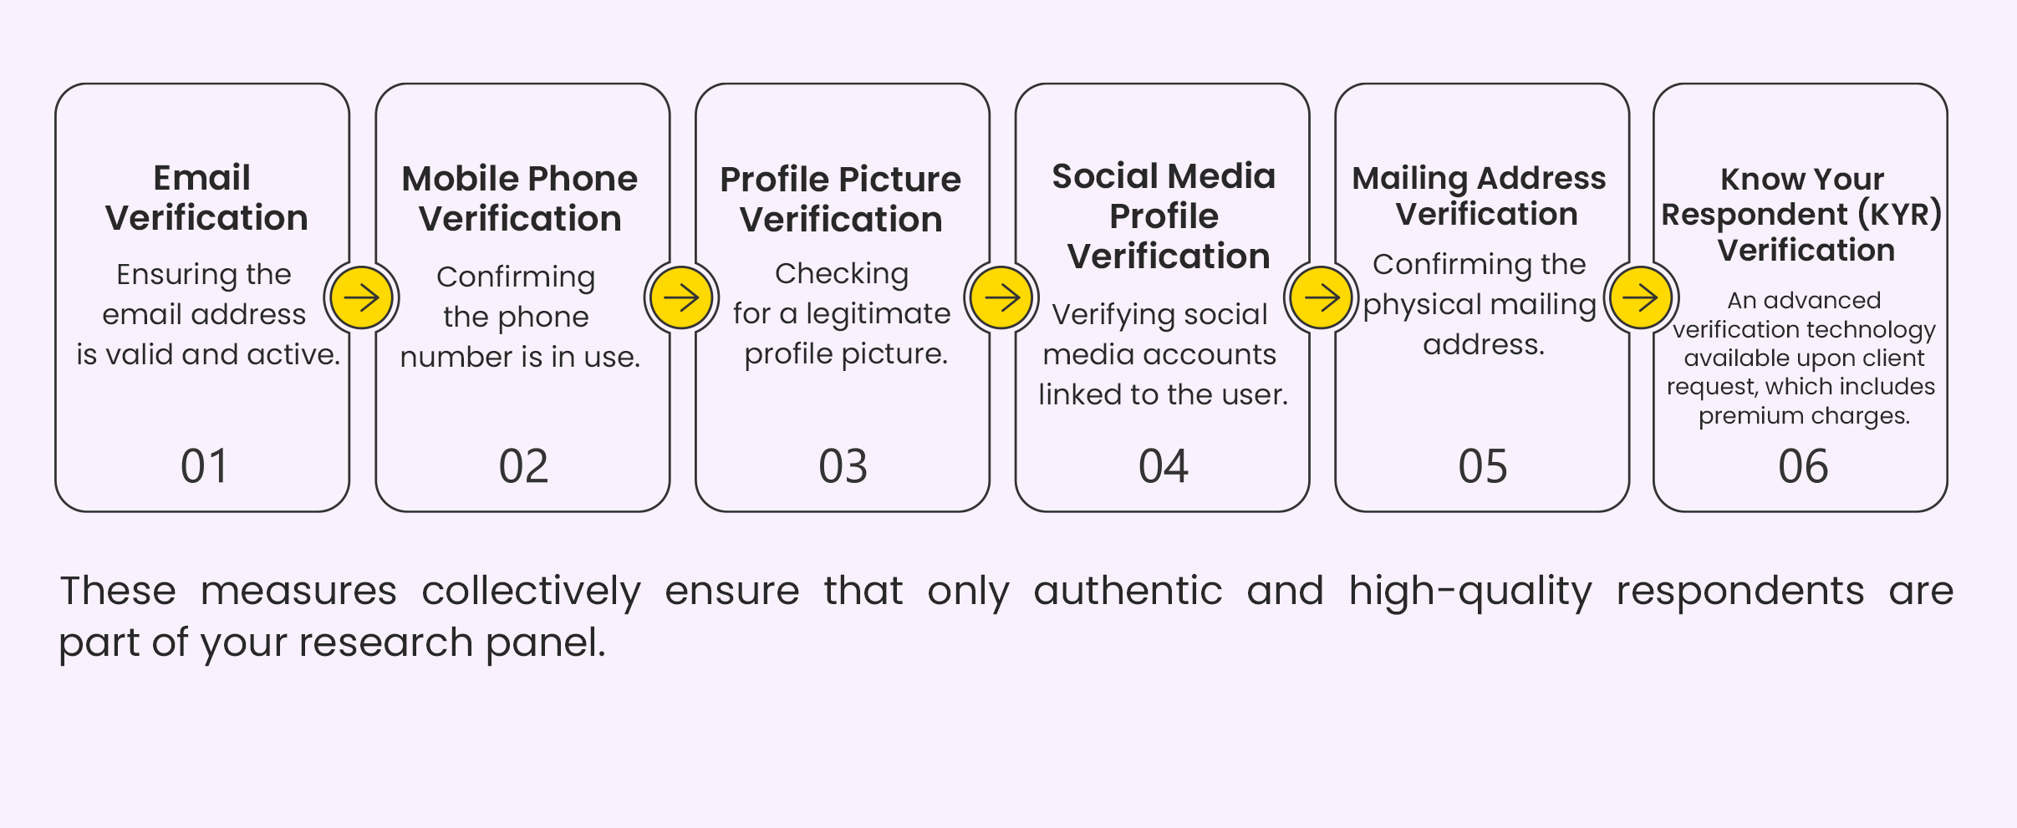
Measure #2 Identity Verification Score (IVS)

Slide 7
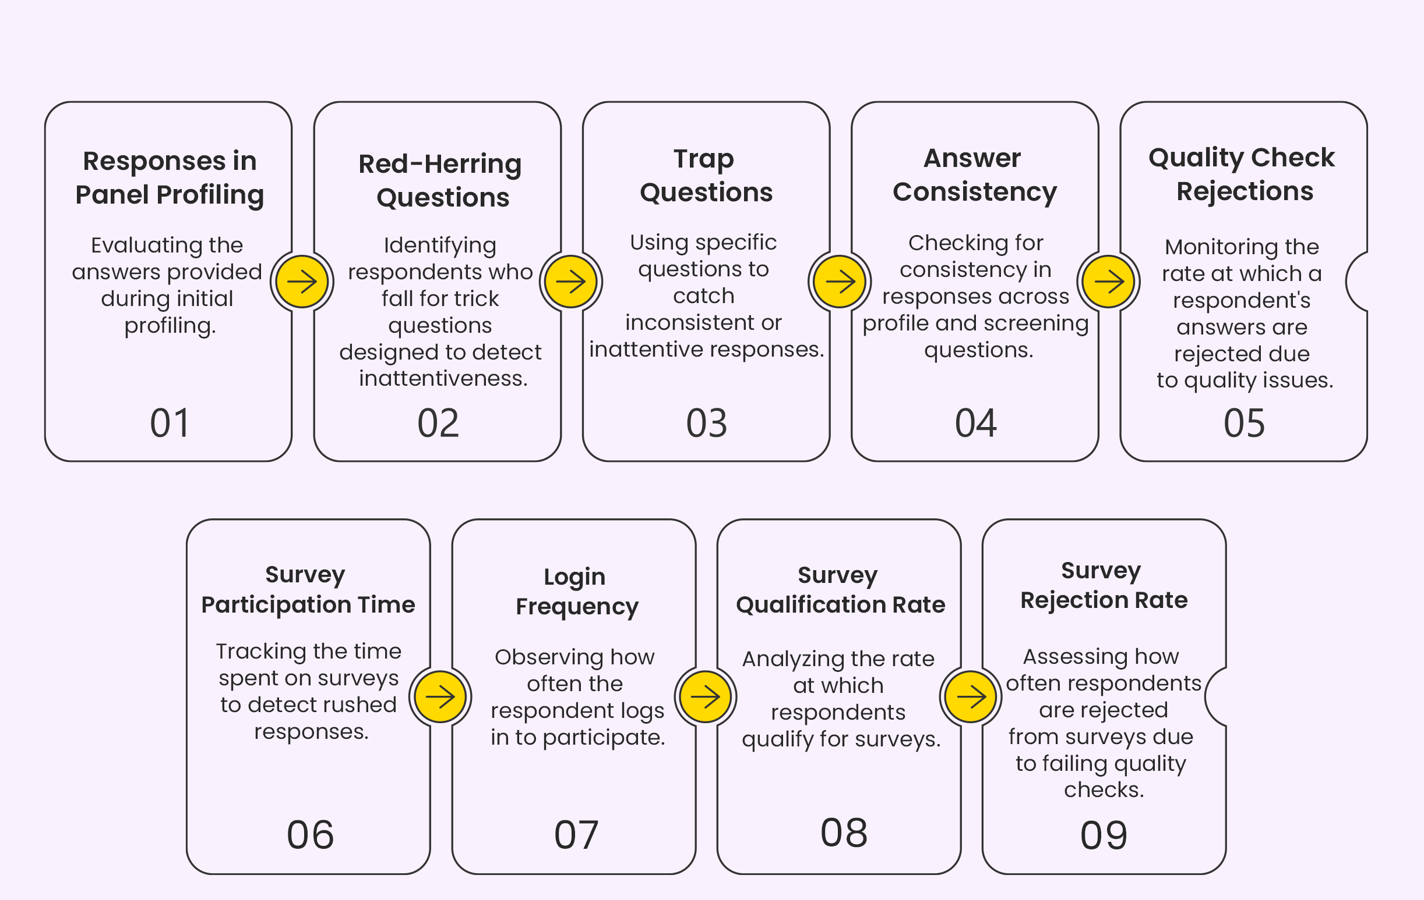
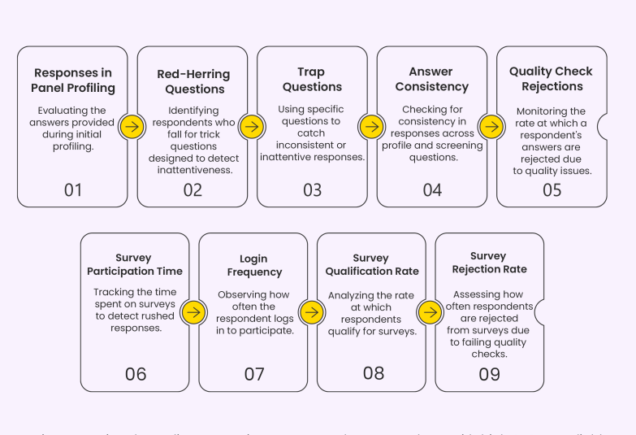
Measure #3 Survey Behaviour Score (SBS)

Slide 8


Your Queries, Our Techniques

Slide 9



Question 1) How do you ensure humans are taking the surveys and not bot users or AI?
We check Google’s invisible reCAPTCHA at the first page where users land to ensure they are not bot. Also, we ask some trap questions during the survey to ensure that respondents are human not a bot or AI.
Survey Participation: Time - Tracking the time spent on surveys to detect rushed or Robot responses.
Bot Detection (Third Party API)
Blacklisted Domain & Email detection (Third-party)

Slide 10




Examples of Trap Questions
1) For this question, please select B as your answer.
2) Which of the following is not a fruit?
options- Apple, Banana, Carrot, Grape.
3) Open ended trap question-
What is your favorite color and why? – To check if the respondent provides a thoughtful answer.

Slide 11



Methods to trap bots or AI in a survey
1) Using CAPTCHA
2) Logic checks and trap questions
3) Randomize question order
4) IP address monitoring
5) Setting up Open ended questions as bots struggle to provide coherent answers
6) Review responses for patterns

Slide 12
Question 2) How do you detect duplicate users?
For identifying duplicates, we first identify their system through cookies, IP, Digital Finger Printing and stop the users if they are duplicates on these parameters. We use cookies, IP tracking, and digital fingerprinting to detect bots.
In the second step, we identify professional survey takers who try to complete a survey solely to earn the offered incentive.
Many professional survey takers use VPNs and multiple systems to bypass the first step. Real-time analysis is conducted by our pre-screens, who detect VPN usage and inconsistencies in answers to filter out such responses.

Slide 13


Verification Methods
Mobile Verification
Email Verification
Duplicate Responses and Survey Behavior Analysis

Slide 14
Question 3) How do you ensure a user is coming to the right region? (eg. a Mexican user isn’t taking a survey meant for an American user)
User’s Geo-IP is checked with survey’s country. If they match, only then a user can enter the survey. Our system identifies if a user is connected though a Proxy/VPN then he/she will not be able to participate in the survey.
To avoid false respondents from other countries, we also put odd time check. For instance, if a user is trying to participate in a survey with any other country time zone, he/she will get terminated.

Slide 15

Verification Methods
Geo-IP Tracking
Device Representation (Desktop Vs Mobile)
Off time Terminate Check
Advance Proxy/VPN Detection Technique (Third party API + Proprietary Technique)

Slide 16
Question 4) How do we ensure the profile of a user is authentic (eg: fake respondent not posing as the required TG)
By tracking multiple sets of user information, we validate the authenticity of respondents and determine whether they are unique or duplicates.
We have developed a unique method to verify users and ensure their authenticity through our Identity Verification Score (IVS). This score is calculated by verifying various identity attributes of each user. The higher the score, the greater the authenticity and quality of the respondent.

Slide 17

Verification Methods
Email Verification: Ensuring the email address is valid and active
Mobile Phone Verification: Confirming the phone number is in use
Profile Picture Verification: Checking for a legitimate profile picture
Social Media Profile Verification: Verifying social media accounts linked to the user
Mailing Address Verification: Confirming the physical mailing address

Slide 18
Question 5) How do you ensure that the user is who they say they are – how do we verify the respondent?
Before being accepted onto our panel, participants must take part in an internal survey. We create users profile based on their responses in internal survey as well as responses provided in a client’s study.
The internal survey is primarily designed based on the profile questions we have, and we check for the consistency of the respondent's answers based on the same.
After a certain period, we also ask some question to keep their profiles up to date and ensure to who they say they are!

Slide 19

Verification Methods
Responses in Panel Profiling: Evaluating the answers provided during initial profiling and during the surveys
Know Your Respondent (KYR) Verification: An advanced verification technology available upon client request, which includes premium charges

Slide 20
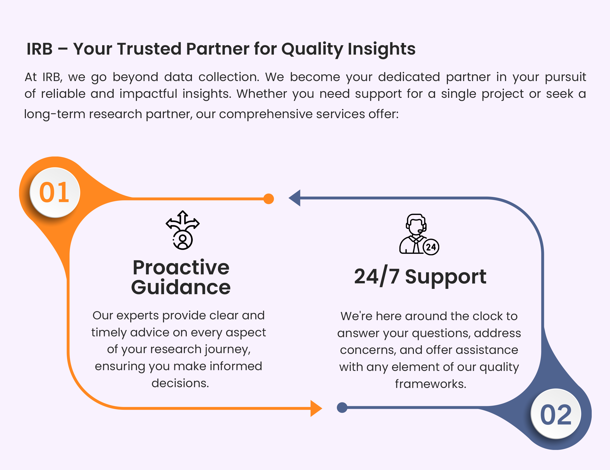

Slide 21

THANK TOU
For watching this presentation
Everest Cantu
+123-456-7890
hello@reallygreatsite.com
www.reallygreatsite.com
123 Anywhere St., Any City, State, Country 12345

