Slide 1
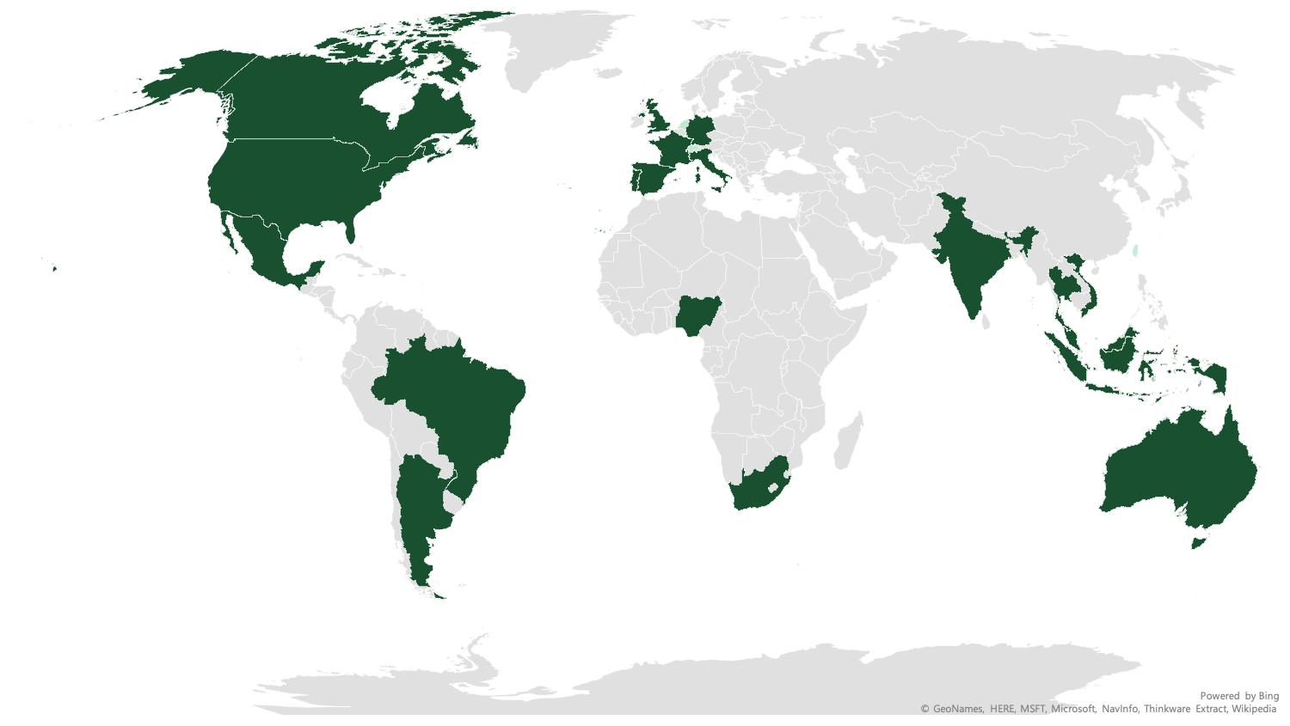
B2C PANEL BOOK
2022
www.irbureau.com

Slide 2
WE ARE IRB
We are a global survey company, specializing in quantitative online research and respondent engagement.
Headquartered in New Delhi and a regional HQ in the US and the UK, Internet Research Bureau serves clients worldwide.
The core services include engaging with B2B panel globally to gain market insights, designing, programming and conduct client surveys.
Industry needs modern and better ways to conduct B2B research surveys, and IRB is proud to take the lead in this direction.
We rely only on organically acquired and smartly managed data

Slide 3
PRIMARY B2C PROFILING
Household
Household Finance
Health & Wellness
Ailments
Daily Lifestyle
Health Insurance
Fitness
Basic profiles
Age and Gender
Shopping
Education
Household Income
Location
Employment status
Parenting
Technology
Internet surfing
Household Applies
Smartphone usage & Activity
Leisure Activity
Travel
Food & Beverages
Computers
Hobbies
Sports & Games
Media & Entertainment
Automotive
Vehicle Ownerships
Make & Model
Purchase DMs

Slide 4
WE ARE EXPERTS IN
Panel Categorization & Profiles
B2C
General | Special | Ailments
Parents Teens & Kids Homeowners Pet owners Car owners Smartphone users (Mobile panel) Tech Enthusiasts Frequent Shoppers Fashion Enthusiasts Insurance owners | High net-worth Individuals Frequent Travelers International Travelers | ADHD Arthritis Asthma Atopic Dermatitis (Eczema) Cancer Cardiovascular Diseases Chronic Rhinosinusitis COPD/Chronic Bronchitis Crohn's Disease/ Ulcerative Colitis Depression/Anxiety Disorder Diabetes T1/T2 | Epilepsy Gout Hepatitis High Blood Pressure, Cholesterol Kidney Disease Migraine Multiple Sclerosis Obesity/Overweight

Slide 5
PROPRIETARY PANEL COUNTRIES

Slide 6
AMERICAS
US | 3,91,612
Canada | 20,357
Mexico | 75,166
Brazil | 2,36,971
Argentina | 24,838
EUROPE
UK | 1,25,155
France | 96,722
Germany | 56,703
Italy | 74,643
Spain | 85,644
Netherlands | 21,767
Portugal | 24,136
Switzerland | 19,127
Poland | 3,511
AFRICA
South Africa | 34,042
Nigeria | 16,380
ASIA-PACIFIC
India | 3,35,370
Singapore | 55,526
Australia | 45,690
Malaysia | 23,489
Hong Kong | 25,268
Thailand | 22,848
Indonesia | 30,351
Japan | 13,021
Taiwan | 15,296
Vietnam | 28,337
Philippines | 12,044
South Korea | 2,278

Slide 7
UNITED STATES
Panel Size: 3,91,612

Slide 10
Country List

Slide 11
CANADA
Panel Size: 20,357

Slide 13
Country List

Slide 14
MEXICO
Panel Size: 75,166

Slide 16
Country List

Slide 17
BRAZIL
Panel Size: 2,36,971

Slide 19
Country List

Slide 20
ARGENTINA
Panel Size: 24,838

Slide 22
Country List

Slide 23
SOUTH AFRICA
Panel Size: 34,042

Slide 25
Country List

Slide 26

NIGERIA
Panel Size: 16,380

Slide 27
Country List

Slide 28
UK
Panel Size: 1,25,155

Slide 30
Country List

Slide 31
FRANCE
Panel Size: 96,722

Slide 33
Country List

Slide 34
GERMANY
Panel Size: 56,703

Slide 36
Country List

Slide 37
ITALY
Panel Size: 74,643

Slide 39
Country List

Slide 40
SPAIN
Panel Size: 85,644

Slide 42
Country List

Slide 43
NETHERLANDS
Panel Size: 21,767

Slide 45
Country List

Slide 46
PORTUGAL
Panel Size: 24,136

Slide 48
Country List

Slide 49
SWITZERLAND
Panel Size: 18,570
Response Rate: 9.67%

Slide 51
Country List

Slide 52
POLAND
Panel Size: 3,511

Slide 54
Country List

Slide 55
INDIA
Panel Size: 3,35,370

Slide 57
Country List

Slide 58
SINGAPORE
Panel Size: 55,526

Slide 60
Country List

Slide 61
AUSTRALIA
Panel Size: 45,690

Slide 63
Country List

Slide 64
MALAYSIA
Panel Size: 23,489

Slide 66
Country List

Slide 67
HONGKONG
Panel Size: 25,268

Slide 69
Country List

Slide 70
THAILAND
Panel Size: 22,848

Slide 72
Country List

Slide 73
INDONESIA
Panel Size: 30,351

Slide 75
Country List

Slide 76
JAPAN
Panel Size: 13,021

Slide 78
Country List

Slide 79
TAIWAN
Panel Size: 15,296

Slide 81
Country List

Slide 82
VIETNAM
Panel Size: 28,337

Slide 84
Country List

Slide 85
PHILIPPINES
Panel Size: 12,044

Slide 87
Country List

Slide 88
SOUTH KOREA
Panel Size: 2,278

Slide 90
Country List

Slide 91
OUR PANEL GROWTH TO DATE

Slide 92
CONTACT
INTERNET RESEARCH BUREAU
Sales Contact: sales@irbureau.com
LOS ANGELES
1055 West,
7th Street Penthouse,
Los Angeles, CA-90017, USA
T: +1-310-6272217
LONDON
Kemp House 160 City Road London EC1V 2NX UNITED KINGDOM
T: +44-2033-183223
NEW DELHI
A-6 (5th Floor), Edenpark Hotel, Shaheed Jeet Singh Marg
New Delhi, 110016, India
T: +91-11-40789940

Slide 93


